Slide 1

AI Futures - The Workforce Odyssey
Team 3
Apr 30, 2024

Slide 2




Team
Yixin Zhang
Dishant Vora
Qingyuan Zheng
Bian Sun

Slide 3
Agenda
Problem Statement
Simulation Overview
Worker
Corporation
Goverment
Summary

Slide 4
Problem Statement
How does the AI impact the complex system involving the corporation, worker, government and the whole society ?
Policy Optimization
Workforce Transformation
Regulation
AI
Employed Structure
Ethics
Production Efficiency
Corporation AI Risk

Slide 5

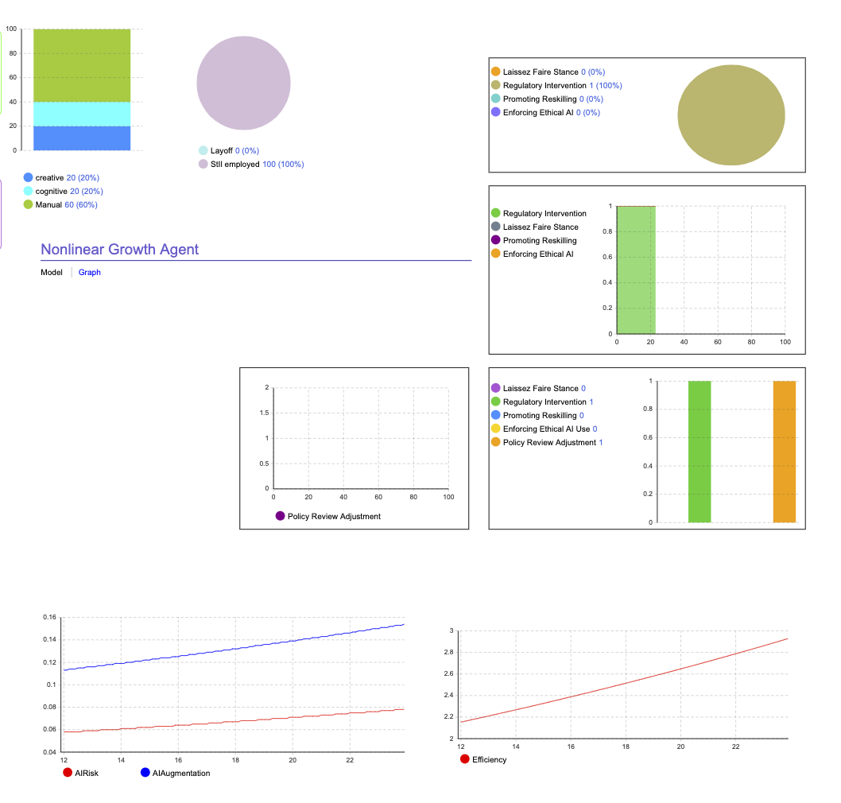
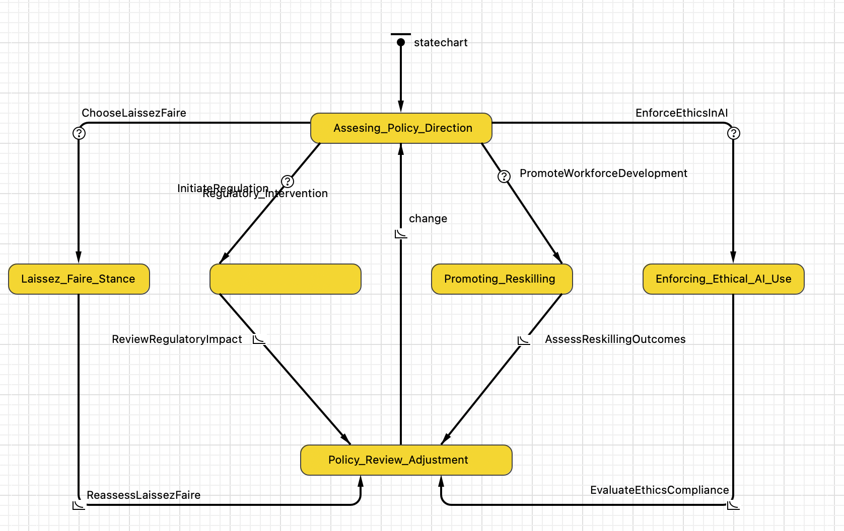
Simulation Overview
Stimulated Data
Java Code
Anylogic
StateChart
Quantization

Slide 6

Worker

Slide 7
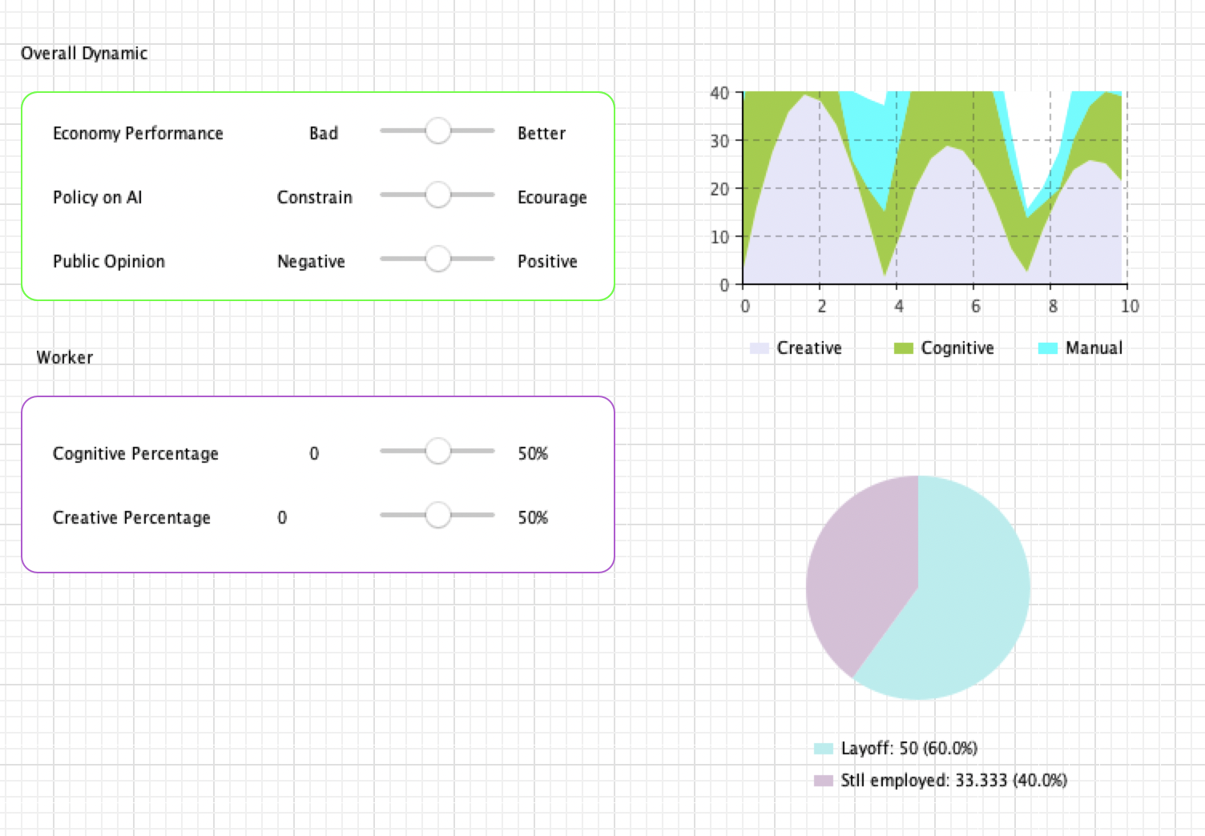
Worker
Parameter:
Economic (Env)
Policy on AI(Goverment)
Public Opinion(Env)
Coginitive Percentage(Worker)
Creative Percentage(Worker)
Variable:
Employment Situation
Proportion of Work Type

Slide 8
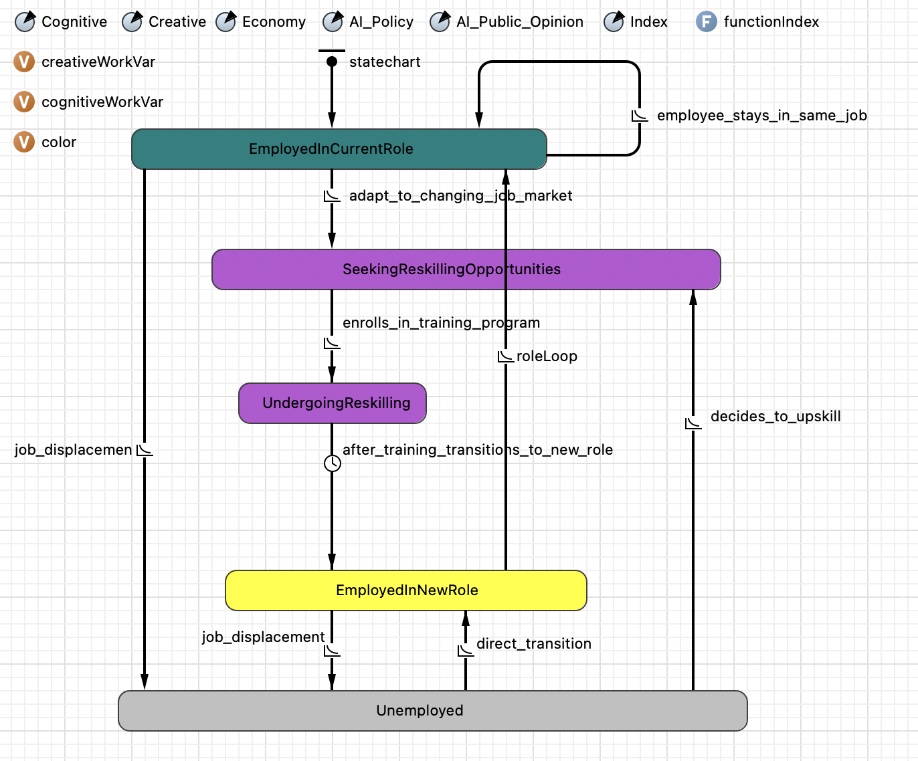
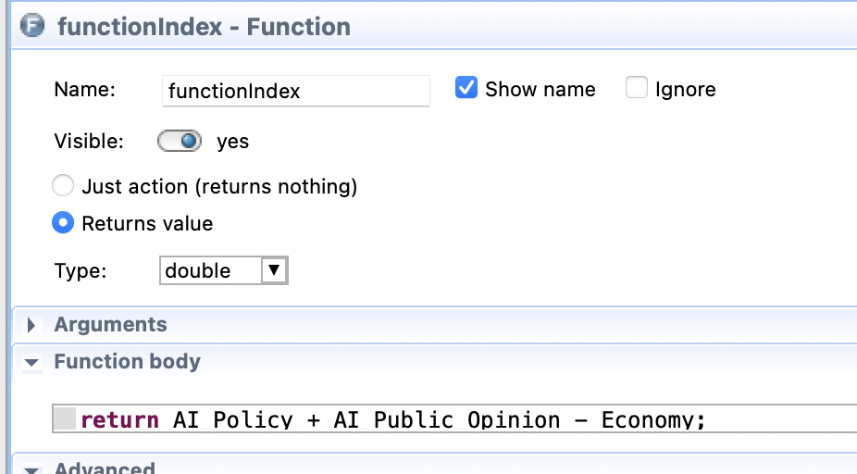
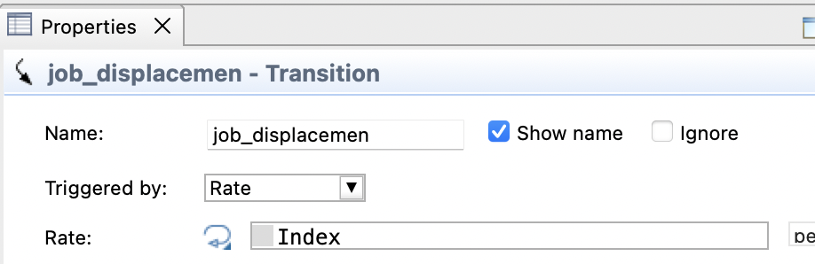
Worker

Slide 9
Worker - Conclusion
With AI integrated in the work, workers will take on more creative and cognitive work.
Although lots of workers will lose their job at first, they will gradually get new job so the unemployment rate will not keep dropping.

Slide 10
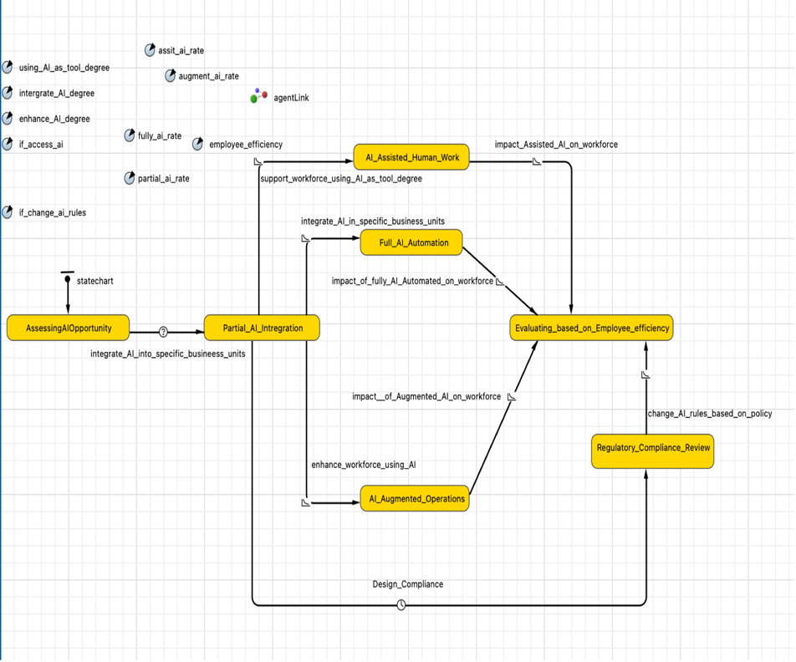
Corporation- Statechart

Slide 11
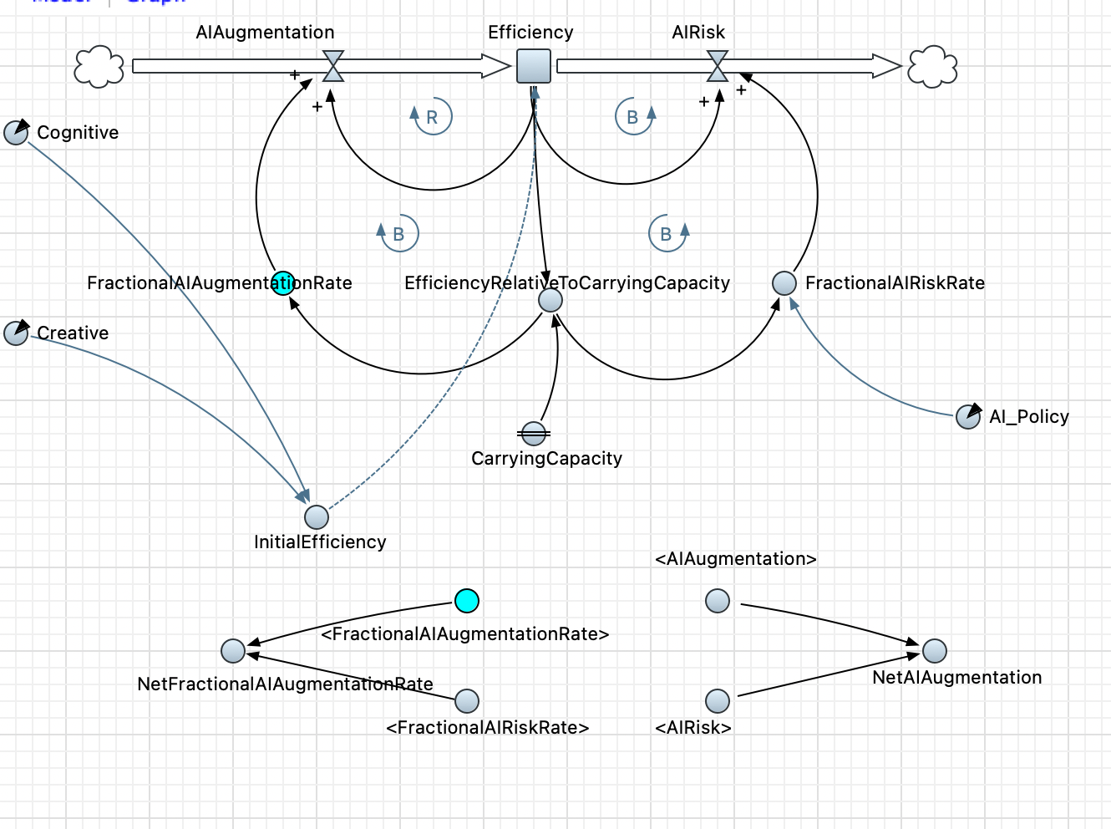
Corporation- Causal Loop
Parameters
Carrying Capacity: In system dynamics, this refers to the maximum load that a system can sustain indefinitely. Because of this, the change of the efficiency of the company will be nonlinear and the efficiency will not grow permanently.
GV_AI_Policy（GV): This refers to government policies or regulatory measures related to AI, which may affect the company's AI risk. If the value of the AI policy is higher, that means the regulatory system will be more relaxed, so the risk will be higher.
Cognitive Percentage(Worker): Will affect the value of the initial Efficiency
Creative Percentage(Worker): Will affect the value of the initial Efficiency
Initial Efficiency: The initial Efficiency of the company has linear relationship with the : Cognitive Percentage(Worker) and Creative Percentage(Worker)

Slide 12
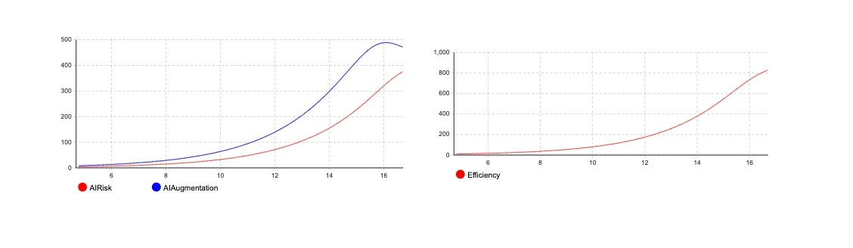
Corporation- Conclusion
With the growth of the AI augumentation, the risk of AI will also grow.
Company can not grow permanently, if it reaches it EfficiencyRelativeToCarryingCapacity, the efficiency can not grow any more, and the AI augmentation will decrease.
Here, our GV policy is positive when it is loose, so the risk of AI in the company will also grow.

Slide 13
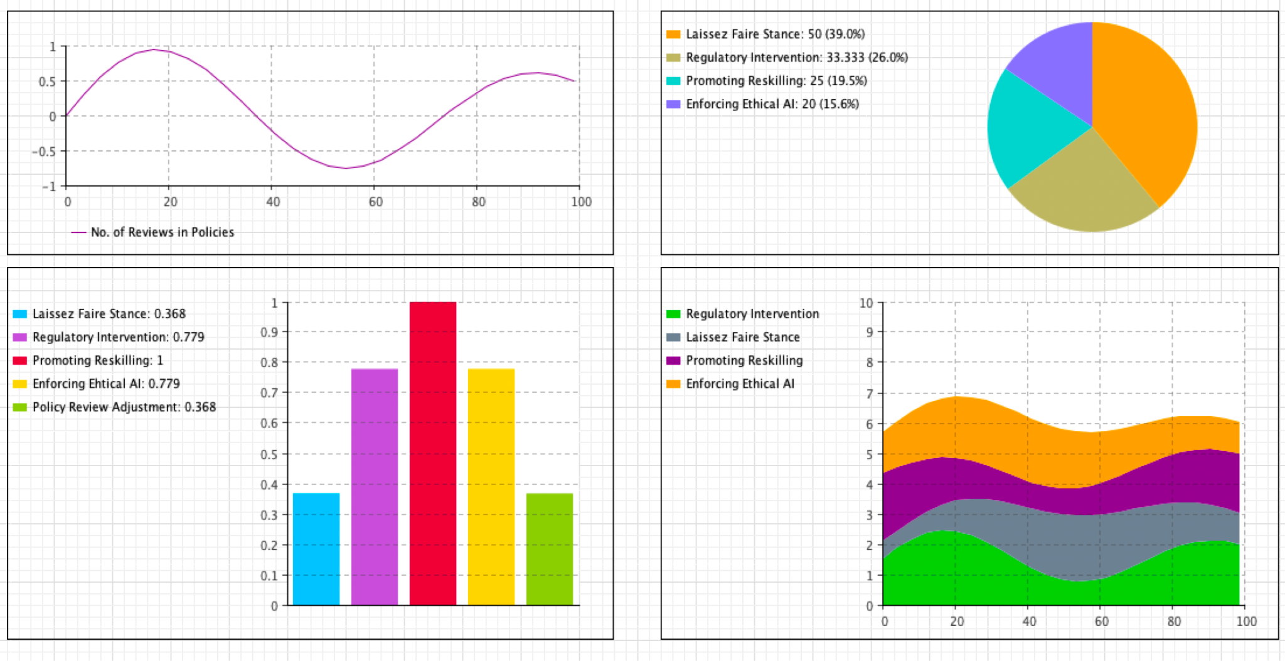
Government
Parameter:
Tax Rate
Public Opinion
Policy on AI
Variables:
laissezCount
regulatoryCount
promotingCount
enforcingCount
reviewCount

Slide 14
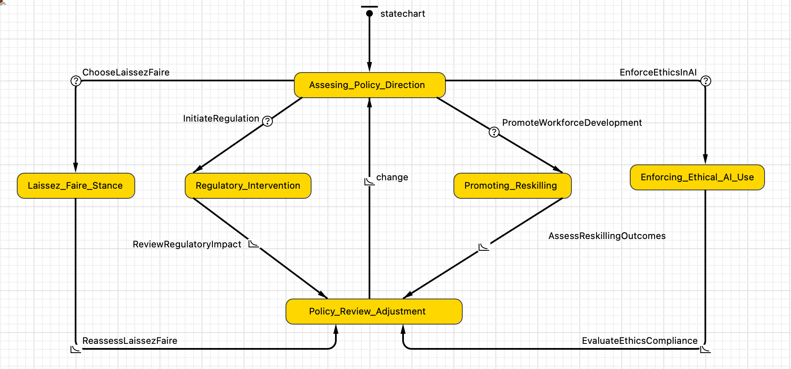
Government - Statechart

Slide 15
Government - Conclusion
Government intervention is crucial in balancing AI innovation with societal safeguards, ensuring ethical standards and public welfare are maintained.
Proactive government policies, such as reskilling initiatives and regulation, effectively mitigate AI-induced job displacements and foster economic stability.
Dynamic government response to public opinion and economic conditions optimizes the integration of AI, enhancing both corporate competitiveness and workforce adaptability.

Slide 16
Final Conclusion
Collaborative strategies across workers, corporations, and governments are essential to harness AI benefits while minimizing its risks.
Support for workforce adaptability, responsible corporate innovation, and thoughtful government regulation is crucial for sustainable economic growth.
The simulation provides actionable insights into managing AI's impact, guiding stakeholders to prepare for a balanced AI-augmented future.

Slide 17
Summary
"AI Futures: The Workforce Odyssey" simulation explores the complex interplay between AI, workers, corporations, and government, highlighting the nuanced impacts of AI on the workforce.
The simulation reveals the importance of collaborative strategies for workforce reskilling, ethical corporate innovation, control AI risk, and adaptive government policies in managing AI's integration.
It serves as a strategic tool for stakeholders to understand and navigate the challenges and opportunities presented by AI in the labor market.

Slide 18
Thank You

